Slide 1

Department of Information and Communication Technology Course Title : Software Development Project-2 Course Code : ICT-2200
Presentation Topic: Brickbreaker Game project.
Presented By:
Md. Shahin Mia
IT-22037
Project Superviser:
Dr. Ziaur Rahman
Associate Professor , Dept. of ICT
Mawlana Bhashani Science and Technology University , Tangail

Slide 2
Welcome to my Presentation
Objectives
About Software development
Introduction of Project
Design and User Interaction
Conclusion

Slide 3
Software Development
Software development refers to a set of computer science activities dedicated to the process of creating, designing, deploying and supporting software.
Software development is like building a digital house. Developers use programming languages like bricks to construct software. They write code, test it for bugs, and make sure it works smoothly. Software developers plan how the program will function. It's a creative process that involves problem-solving and teamwork to bring ideas to life in the digital world.

Slide 4
Introduction of Project
Overview of the Brick Breaker game
Purpose of the project
Tools used: Java, IntelliJ IDEA, MySQL, Maven

Slide 5
Technologies Used
Java (OpenJDK 24)
MySQL Database
Maven Build Tool
IntelliJ IDEA
JDBC (mysql-connector-j-9.3.0.jar)

Slide 6
Game Design
Brick layout using MapGenerator
Paddle & ball movement logic
Scoring and collision detection in GamePlay

Slide 7
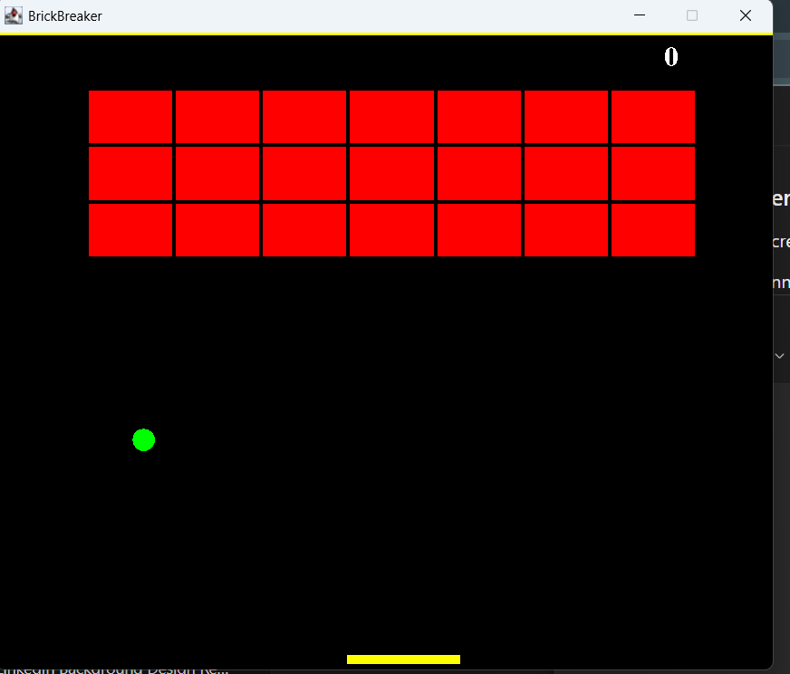
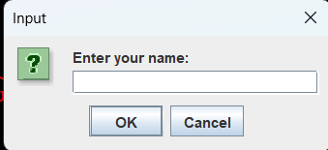
Design and User Interaction(Cont..)
After taking the players name, the program shows the game window like this:

Slide 8
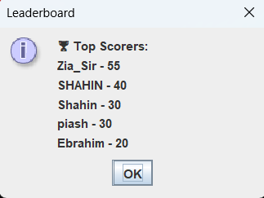
Database Integration
Class: DatabaseManager.java
Stores:
Player scores
High scores history

Slide 9
Challenges Faced
Integrating MySQL with Java
Designing collision detection logic
Game loop and frame refresh rate

Slide 10
Conclusion
Summary of features developed
Skills gained during the project
Final outcome of the game

Slide 11
THANK YOU

